Slide 1

Harmonize Space
Presented by Group 5
Shubham Kumar
Bishyan Kar
Simran Mittal
Madhusree Bera

Slide 2

Harmonize Space
A utility software for desktop, android phones and web browsers that will provide various tools to make online meetings, browsing and organising more productive.

Slide 3




Harmonize Space
Key Features:
Meeting Audio Transcription
Meeting Scheduler
Website Highlighter
Clipboard Synchronization

Slide 4



Harmonize Space includes
Desktop Application
Harmonize Space
Browser Extension
Mobile Application

Slide 5














Tech Stacks

Slide 6
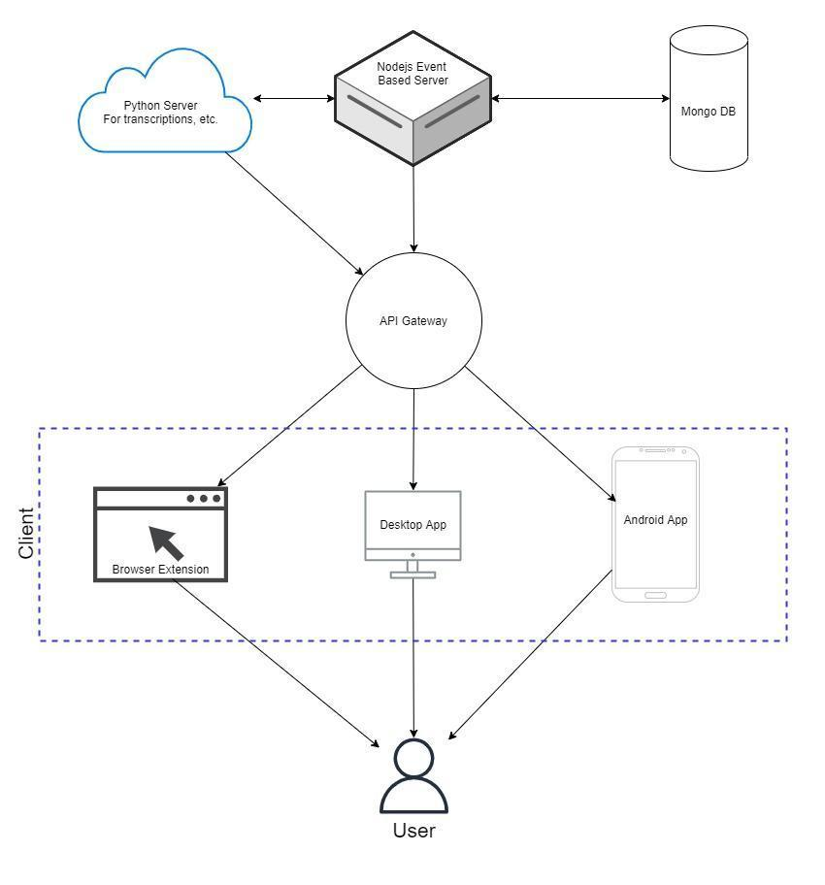
Architecture Diagram

Slide 7
Prototype
Meeting Audio Transcriptor: Desktop App

Slide 8
Audio Transcriptor: Mobile App

Slide 9
Prototype
Meeting Scheduler

Slide 10
Prototype
Website Highlighter

Slide 11
SWOT ANALYSIS
STRENGTHS
Demand in market for functionalities provided by “Harmonize Space”
WEAKNESSES
Recording Meeting in Android is not allowed
S
W
Use cases increases with digitalization of conferences
OPPORTUNITIES
Future Operating Systems of Desktop prohibits meeting recording/ screen recording
THREATS
O
T

Slide 12
Comparative Analysis
Features | Web Highlighter | Transcripting | Auto Scheduling meeting | Sync clipboard
LINER | ✔ | x | x | x
MS Teams | x | ✔ | x | x
Google Meet | x | ✔ | x | x
Zoom | x | ✔ | x | x
Calendly | x | x | ✔ | x
Proposed system (Harmonize Space) | ✔ | ✔ | ✔ | ✔

Slide 13
Turning into an Entrepreneurship Venture
Blue Ocean Strategy
Create uncontested market space
Make the competition irrelevant
Create and capture new demand
Align the whole system in pursuit of differentiation and low cost

Slide 14
Funding Ventures
Bootstrapping: build a company from personal finances
Angel Investors: an individual who provides capital for a business start-up, in exchange for convertible debt or ownership equity.

Slide 15
Future Scope
Schedule meeting using voice commands
Feature to organize online meeting

Slide 16
Conclusion
Project Benefits
Online Meeting - enable users to generate and save live transcripts, take notes, etc.
Sharing - Users will be able to share content across their devices with much ease
Browsing - Enables users to highlight important texts in the websites and search later

Slide 17
References
What is Blue Ocean Strategy
Bootstrapping Definition
Angel investor - Wikipedia
Group Chat Software - Free Chat for Teams | Microsoft Teams
Zoom
Google Meet: Video conferencing for business
https://getliner.com/en
https://calendly.com/

Slide 18
Thank You

